Slide 1

Resource Management
http://www.in.all.biz/img/in/service_catalog/22027.png
G.R. Labbé

Slide 2

Lecture 1
Introduction to Project Management and Communication
Lecture 2
Project Scope, Charter, Organizational Structure
Lecture 3
Leadership and the Project Manager
Lecture 4
Work Breakdown Structures (WBS)
Lecture 5
Network Diagrams and Activity on Node (AON)
Lecture 6
Risk Management
Lecture 7
Project Scheduling
Lecture 8
Costs Estimation
and Budgeting
Lecture 9
Negotiation and
Conflict Management
Lecture 10
Resource Management
Lecture 11
Control Systems
Lecture 12
Project Closeout and Termination

Slide 3

Constraints on Projects
As described in the very beginning, all projects run in an environment of constraints.
TECHNICAL CONSTRAINTS
PHYSICAL CONSTRAINTS
RESOURCE CONSTRAINTS
People
Materials
Space
Money
Equipment
In this lecture we look in detail at the resource constraints and techniques to improve their utilization through Resource Leveling and Resource Smoothing.
http://www.absecmy.com/project-theme/images/template/icons/resources.jpg

Slide 4
Resource Leveling
Defined by PMBOK as:
“A technique in which start and finish dates are adjusted based on resource constraints with the goal of balancing demand for resources with the available supply.”

Slide 5
Resource Leveling
Assumption is that you are working in a "Project Organization", meaning everyone of the team is working 100% on your project.
Resource Leveling has two objectives:
To determine the resource requirements so that they will be available at the right time.
To allow each activity to be scheduled with the smoothest possible transition across resource usage levels.

Slide 6
Resource Loading Chart demonstrating Over-Allocation
With a Gantt chart like this it is easy to see that John is over-allocated. This assumes that he is utilized 100 % of the time every day. What if this was not the case.
Would you be able to tell?
If you create a Gantt chart that shows resources, you could determine if the scheduling above would work.

Slide 7
Resource Loading Chart demonstrating Over-Allocation
In this chart you group the resources and then list the tasks each has been assigned to. In this manner it is easy to see the amount of time that each resource is going to be utilized each day.
ID
Resource Name
Details
31 Dec '07
07 Jan '08
14 Jan '08
1
John Smith
Work
M
T
1d
W
2d
T
F
S
S
M
T
W
T
1 d
F
S
S
M
T
A. Contract Signing
Work
1 d
2d
2d
2d
2d
2d
1d
1d
D. Survey Sample
Work
.5 d
1d
.75 d
1d
1d
1d
1d
..5 d
1d
1d
1d
G. Demographic analysis
Work
.5 d
1d
.25 d
1d
1d
1d
1d
.5 d
1d
H. Presentation to client
Work
2
Sue Bailey
Work
B. Questionnaire Design
Work
3
Tom Jones
Work
1d
C. Target Market ID
Work
1d
4
Steve Cooper
Work
1d
C. Target Market ID
Work
1d
5
Sandra Hobbs
Work
1d
1d
1d
1d
1d
1d
E. Develop Presentation
Work
1d
1d
1d
1d
1d
1d
6
Ian Tinnings
Work
F. Analyze results
Work

Slide 8
Rules of Thumb when solving Resource Leveling problems
When dealing with Resource Leveling problems deal with the tasks in this order:
Activities with the smallest amount of slack;
Activities with the smallest duration;
Activities with the lowest activity identification number (e.g. those that start earliest in the WBS);
Activities with the most successor tasks; and
Activities requiring the most resources.

Slide 9
6
2
4
3
3
2
4
3
4
2
5

Slide 10
Resource Loading Chart
Resource level limit: 9 people/day
Before Resource Leveling

Slide 11
Resource level limit: 9 people/day
After Resource Leveling

Slide 12
Sample Project Network
4 B 5
Res = 2
5 D 9
Res = 7
9 E 11
Res = 3
0 A 4
Res = 6
11 F 12
Res = 6
4 C 7
Res = 2
Resource level limit: 8 resources/week
Task C is the only one with slack available.
Remember first to level those tasks with the smallest amount of slack.
All tasks are on critical path, except C. Therefore, they all have priority over C

Slide 13
4 B 5
Res = 2
5 D 9
Res = 7
9 E 11
Res = 3
0 A 4
Res = 6
11 F 12
Res = 6
4 C 7
Res = 2
Resource level limit: 8 resources/week
C is the only task available for leveling => find new home for it.

Slide 14
4 B 5
Res = 2
5 D 9
Res = 7
9 E 11
Res = 3
0 A 4
Res = 6
11 F 12
Res = 6
4 C 7
Res = 2
Days
C is the only task available for leveling => find new home for it.

Slide 15
Resource Loading Charts
Resource loading charts used to display the amount of resources required as a function of time on a graph.
Each activity is typically represented in the charts as a block.
10
9
8
7
F
6
E
Resources
C
5
D
4
B
3
A
2
1
0
1
2
3
4
5
6
7
8
9
10
11
12
13
14
Project Days

Slide 16
1 2 3 4 5 6 7 8 9 10 11 12 13
Days
How can we let the project finish on the original end day (12)?

Slide 17
Resource Load Chart before leveling
10
9
8
7
F
6
E
Resources
C
5
D
4
B
3
A
2
1
0
1
2
3
4
5
6
7
8
9
10
11
12
13
14
Project Days
C is the only task available for leveling => find new home for it.

Slide 18
Resource Loading Charts
Resource loading charts used to display the amount of resources required as a function of time on a graph.
Each activity is typically represented in the charts as a block.
10
9
8
7
F
6
E
Resources
C
5
D
4
B
3
A
2
1
0
1
2
3
4
5
6
7
8
9
10
11
12
13
14
Project Days

Slide 19
Resource Load Chart after Leveling and Splitting Task C
10
9
8
7
F
6
E
Resources
D
5
4
C
B
3
A
2
1
0
1 2 3 4 5 6 7 8 9 10 11 12 13
Days

Slide 20
Splitting a task
Means interrupting the continuous stream of work on an activity at some point in its progress and applying that resource to another activity. Then returning to the original task.
Splitting can be useful provided there are no excessive costs associated with splitting the task. For example, large start-up or shutdown costs make splitting an unattractive option.
Only some tasks can be split.

Slide 21
Resource Leveling Example
Create a Resource Load Chart from the following AON network diagram, and level it to 9 personnel per day. You can split the tasks.
0 A 3
5 personnel
3 B 8
4 personnel
9 E 11
5 personnel
0 C 7
2 personnel
7 D 9
8 personnel

Slide 22
Create a Resource Load Chart from the following AON network diagram, and level it to 9 personnel per day. You can split the tasks.
0 A 3
5 personnel
3 B 8
4 personnel
9 E 11
5 personnel
0 C 7
2 personnel
7 D 9
8 personnel

Slide 23
Resource Smoothing
Resource Smoothing is similar to Resource Leveling
Resource Leveling deals with a limited amount of a resource, a resource is only available at certain times, or the resource is over-allocated
In resource leveling it’s sometimes necessary to extend the project duration (although this is not desired)
Resource Smoothing is done after Resource Leveling
It never extends the project duration, it just tries to use resources more efficiently by using available slack
G. Labbé and R. Schott

Slide 24
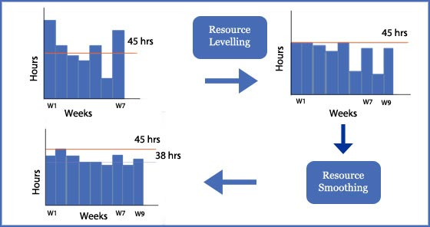
Resource Smoothing
Here the project only has 45 hours of a resource per week, so it is leveled to that, but that extends the duration from seven weeks to nine weeks
After resource smoothing, the resource is used about the same each week (~38 hours)
https://www.izenbridge.com
G. Labbé and R. Schott

Slide 25
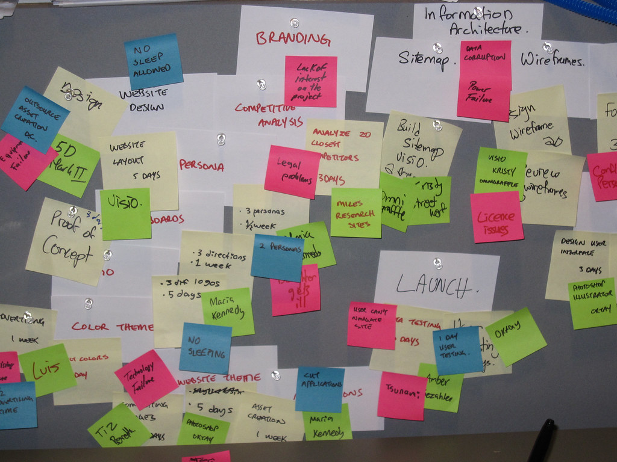
Resource Allocation across Multiple Projects
Often different projects will use similar resources
Rather than acquire new resources for each project, your organization will usually share resources across multiple projects
https://www.flickr.com/photos/vancouverfilmschool/5331017892
G. Labbé and R. Schott

Slide 26
Resource Allocation across multiple projects
The main challenge is interdependency:
Any resource allocation decisions made in one project are likely to have ramifications in other projects.
Some of the more common problems with interdependency among projects:
Inefficient use of resources;
Resource bottlenecks;
Ripple effects; and
Heightened pressure on personnel to multitask.

Slide 27
Resource Allocation across multiple projects
Any system used to optimize the complex problems with multi-project resource allocation must consider the need, and as much as possible, to minimize the negative effects of these three key factors:
Schedule slippage
Resource Utilization
In-Process Inventory (WIP)

Slide 28
1. Schedule Slippage
For many projects this is more than the realization that the project will be late. In many industries this can result in serious financial penalties. It is not uncommon for companies to charge thousands of dollars in penalty clauses for each day a project is delayed.
In these cases, it is very important to consider the priority level a project gets based on the impact of schedule slippage for each individual project

Slide 29
2. Resource Utilization
The goal of every company is to use the existing resources as efficiently as possible. Adding resources can be expensive and may not be necessary.
The tan area in the chart shows the available resources not used in the current project.
To maximize resource utilization, the available resources would be assigned to other, concurrent, projects thereby improving the overall efficiency with which we use project resources.
Unused Resources

Slide 30
3. In-Process Inventory
The third standard for analyzing the optimal use of multi project resources is to consider their impact on In-Process Inventory. In-Process Inventory represents the amount of work waiting to be completed but delayed due to unavailable resources.
For example, an automotive company may find several resources delayed because it only has one set of climate chambers for testing. The projects stack up behind this resource bottleneck and represent the company's In-Process Inventory of projects.
Excessive In-Process Inventory is often caused by a lack of available resources and represents the kinds of trade-off decisions companies must make in multi project environments. Does it make sense to hire more resources? Is the bottleneck only temporary, leading to inefficient resource allocation later if you purchase new resources?

Slide 31
Resolving Resource Decisions in Multi-project Environments
There are several methods for resolving resource allocation problems:
"First in Line" or "first come-first served" is the simplest rule of thumb for allocating resources. It is easy to employ, it simply follows the master project calendar. The earliest project gets scheduled first. This method ignores any other important information such as priority, emergency situations, preference due to higher commercial success of other projects.
Greatest Resource Demand With this decision rule the project with the highest demand of resources get scheduled first. Then the remaining projects are examined and scheduled according to their level of resource demand. The logic in this method is that in this way the resource bottlenecks will show up very quickly and it can be used as a starting point for potential additional resource allocation.

Slide 32
Resolving Resource Decisions in Multi-project Environments
Greatest Resource Utilization (Most types of resources)
Is a variation on the above rule. This rule schedules the project first that uses the most types of resources.
E.g. a company wants to run two projects A and B across a resource pool made up of programmers, system analysts and networking staff. Project A utilizes a lot of programmers. Project B utilizes all three resource types, but much less.
Using this rule, a company will prioritize project B above A in order to ensure that all resources are being utilized to the greatest extent.

Slide 33
Resolving Resource Decisions in Multi-project Environments
Minimum Late Finish Time (Earliest Finish First)
This rule prioritizes projects based on finish dates. The one with the earliest late finish date will be prioritized.

Slide 34
Resolving Resource Decisions in Multi-project Environments
Mathematical Programming
The common objectives these models seek to minimize are:
Minimize total development time for all projects;
Minimize resource utilization across all projects; and
Minimize total lateness across all projects.
While mathematical programming is a worthy approach to resolving the constrained resource problem, it tends to be limited due to the complexity of the problem, the large number of variables and the time necessary to generate a sufficiently small set of options.

Slide 35
Summary
Resource management in projects is a problem that is frequently overlooked by novice project managers or in firms that have not devoted enough time to understanding the full nature of the project management challenge they face.
As noted, it is common to develop project plans and schedules under the assumption of unlimited resources as if the organization can always find the trained personnel and other resources necessary to support project activities. This practice inevitably leads to schedule slippages and extra costs as the reality of resource availability overshadows the optimism of initial scheduling.
Use Resource Management to avoid these downfalls.

Slide 36
Discussion Questions
It has been argued that a project schedule which has not been resource leveled is useless. Do you agree or disagree with this statement? Why or why not?
How does resource smoothing affect multi-project scheduling?
Multi-tasking can have an important negative impact on your ability to resource level a project. When your team members are involved in multiple additional commitments, we must be careful not to assign their time too optimistically. In fact, it has been said: “Remember, 40 hours is not the same as one week’s work.” Comment on this idea. How does multi-tasking make it difficult to accurately resource level a project?
Why is resource management significantly more difficult in a multi-project environment? What are some rules of thumb to help project managers better control resources across several simultaneous projects?
G. Labbé and R. Schott

Slide 37
Discussion Questions
Consider a project to build a bridge over a river gorge. What are some of the resource constraints that would make this project challenging?
Discuss the nature of “time/cost tradeoffs” on projects. What does this concept imply for our project management practices?
When resource leveling a project, there are several heuristics that can help us prioritize those activities that receive resources first. Explain how each of the heuristics works and give an example.
For many projects, the key resources to be managed are the project team personnel. Explain in what sense and how project team personnel are often the project critical resource.
What is the philosophy underlying resource loading? What does it do for our project? Why is it a critical element in effectively managing the project plan?
G. Labbé and R. Schott

